Slide 1

Communication Skills and Technical Writing
Course code: Pc 512

Slide 2
Aim of the course
Equip students with the communication skills required to succeed in professional and workplace settings.
Develop the ability to deliver, clear, confident and effective presentations to both technical and non-technical audiences.
Introduce students to the principles and various forms of technical writing used in academic and professional contexts.

Slide 3
“Communication is more important than technical knowledge?” Agree or disagree

Slide 4
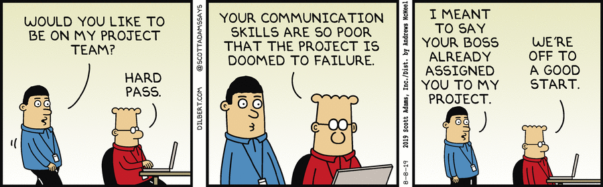
Describe the picture
One student will take a look at the picture.
He/she will describe the picture-the shape, colour, usability etc.
The other students have to guess the image in 5 minutes.

Slide 5
I. What is communication?
Noun. [uncountable] the activity or process of expressing ideas and feelings or of giving people information.
Examples:
1) Speech is the fastest method of communication between people.
2) Doctors do not always have good communication skills.

Slide 6



II. Communication as a countable noun
[countable] (formal): a message, an email, letter or telephone call
Example: a communication from the president of the company.

Slide 7
How many times have you communicated today, and how?

Slide 8

Observe the image and answer the following questions
What should you communicate?
To whom should you communicate?
Why should you communicate?
When should you communicate?
How should you communicate?

Slide 9
5 IMPORTANT QUESTIONS FOR EFFECTIVE COMMUNICATION
What? Exactly what is my subject matter.
Who? With whom do | wish to communicate.
What is my purpose in communicating?
When and where? Are there features about the place and time which affect how | should write or speak.
What type of communication am | aiming at? —narration/ description/ argument.

Slide 10
GENERAL COMMUNICATION | TECHNICAL COMMUNICATION
Contains a general message | Contains a technical message
Informal in style | Mostly formal
No set pattern of communication | Follows a set pattern
Mostly oral | Both oral and written
Not always for a specific audience | Always for a specific audience
Does not involve the use of technical vocabulary or graphics etc. | Involves use of jargon, graphics etc.

Slide 11
Difference between business and technical communication
Emails are crux of business writing. Other types of business writing include letters, reports, blog posts, articles, and more.
People in specialized fields write documents that relate to technical or complex subjects.
Unlike business documents, technical documents are often a collaborative effort between a technical writer, UX writer, subject matter expert, editor, and others.
Kinds of technical documents: Abstracts, articles for publication, executive summaries, reports, user manuals, functional and detail specifications

Slide 12
What makes technical communication unique?
The biggest difference between technical communication and the other kinds of writing you have done is that technical communication has a somewhat different focus on audience and purpose.

Slide 13
Example 1
Let us take an example of a customer who has bought a washing machine and does not know how to use it. The customer reads the instructions in the user manual and gradually learns to operate the washing machine without any assistance. This is an example of successful technical communication.

Slide 14
Example 2
If the communication is through a user manual for a phone, remember that people will usually never use it unless they are stuck. And if they are stuck, they will look for instant information to solve their problem. The information must be brief and arranged sequentially so that it is easy for a user to find relevant information. It is also vital that the technical information provided in the manual be accurate.

Slide 15
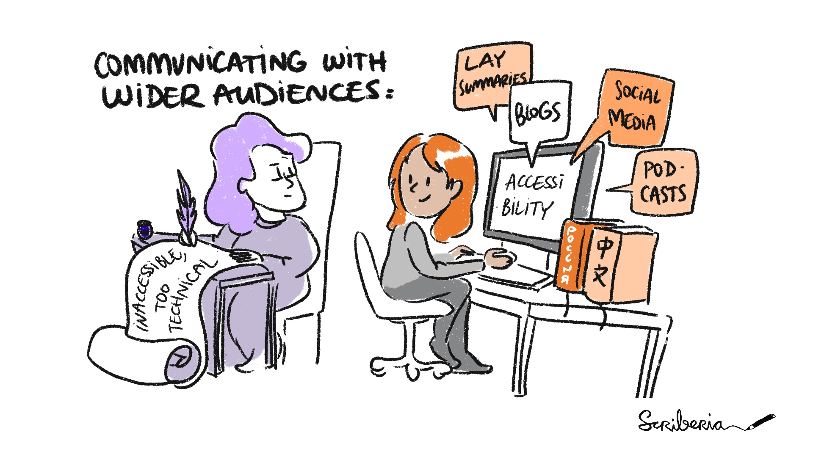

Slide 16
The Course Structure
The course is divided into 7 modules.
Each module is designed to equip you with at least one skill needed for technical writing and communication.

Slide 17
Module 1:Foundations of Professional Communication
Communication process
Technical vs General Communication
Barriers to Communication
Principles of clear communication
Audience analysis

Slide 18
Module 2: Listening and Speaking for Engineers
Active Listening
Asking effective questions
Public Speaking fundamentals
Technical discussions
Giving and receiving feedback

Slide 19
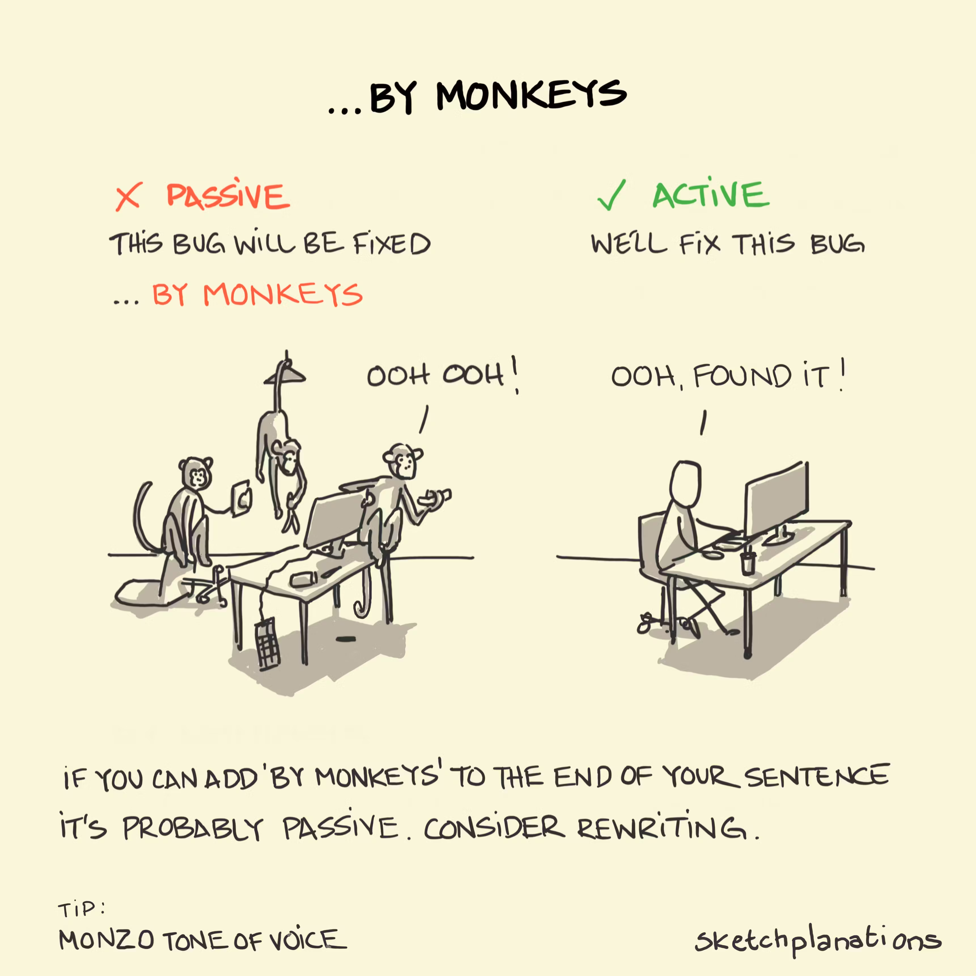
Module 3: Reading and Writing Technical Documents
Reading technical and research documents carefully
Skimming and scanning method for quick reading
Importance of grammar in technical communication
Writing emails, letters
Precis writing and summarization

Slide 20
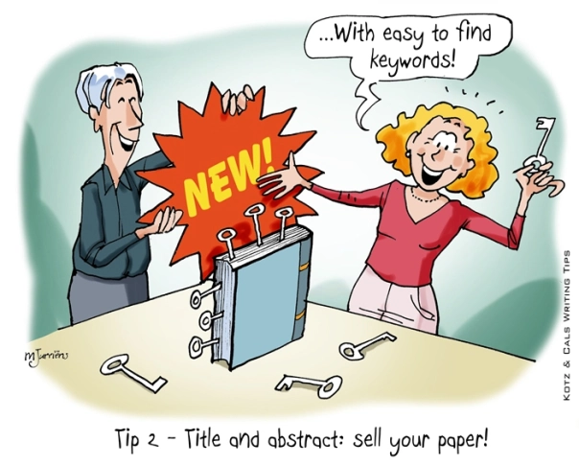
Module 4: Reading and Writing
Writing research papers, dissertation and thesis
Organizing references, developing a bibliography and styling
Tips for publishing papers in journals

Slide 21
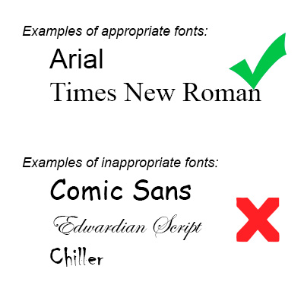
Module 5:Presenting Research
Writing and presenting a paper in a conference
Poster presentation techniques.

Slide 22
Module 6:Career Communication
Making a resume or CV
Types of interviews and tips for acing them
Group Communication: Organizational GD
Professional networking
LinkedIn profile

Slide 23


Can you identify the use of the following softwares?

Slide 24
Overleaf is a collaborative cloud-based LaTeX editor used for writing, editing and publishing scientific documents.
Zotero is free and open-source reference management software to manage bibliographic data and related research materials, such as PDF and ePUB files

Slide 25
Module 7: Workplace Communication
Meetings, negotiations
Technical proposals and reports
Ethics in technical communication
AI tools in communication
Introduction to LibreOffice, Suite, Markdown, LATEX and Beamer.

Slide 26
Grading Policy
Participation in 2 in-class activities: 30%
In-Sem. Exam 2: 30%
End-Sem. Project: 40%
If any instance of plagiarism, copying, and cheating is detected an “F” would be given as the final grade.

Slide 27
Participation in class activities
Participation of students in class discussions ensures effective learning. Hence, all of you are encouraged to attend and participate in class regularly.

Slide 28
Essential readings
Raman, Meenakshi and Sangeeta Sharma. Technical Communication: Principles and Practice. Second Edition. New Delhi: OUP, 2011.
M. Ashraf Rizvi, Effective Technical Communication, Second Edition (McGraw Hill Education Private Ltd. , 2018)
Elizabeth Tebeaux and Sam Dragga ed., The Essentials of Technical Communication (Oxford University Press, 2021).
Seth Lindstromberg ed., The Standby book: Activities for the language classroom (Cambridge University Press, 1997) . A later edition of this book would also be fine.
Mario Linvolucri and Paul Davis, More Grammar Games: Cognitive, Affective and Movement activities for EFL students (Cambridge University Press, 1995)
John Seely, The Oxford Guide to Effective Writing and Speaking, Third Edition (Oxford University Press, 2013).
Justin Zobel, Writing for Computer Science, Third Edition (Springer, 2014).

Slide 29
Contact Information
Course instructor: Purbasha Das
Office Address: Room 4210, FB-4
Email: purbasha_das@daiict.ac.in

Slide 30
Tasks for this week : To be discussed in the next class
Research the kinds of communication you will do in your career.
You might interview a member of your chosen profession.
What kinds of documents and presentations will you produce, and for what audiences and purposes?

